Slide 1
Face Detection with PyTorch

Slide 2
Purpose
The purpose of this demo is to show how you could train your own Face Detection model
The model will be similar to the MediaPipe model we used in the last demonstration
We will be using PyTorch for this purpose

Slide 3
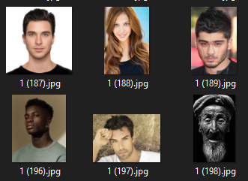
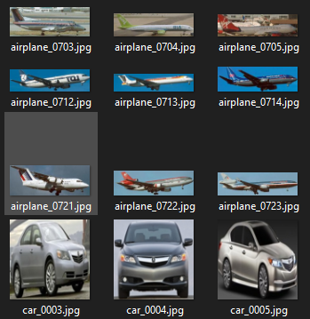
Dataset
The dataset is images of human faces and no faces
The “no faces” part of the dataset are a collection of images of objects; cars, planes, dogs, cats

Slide 4
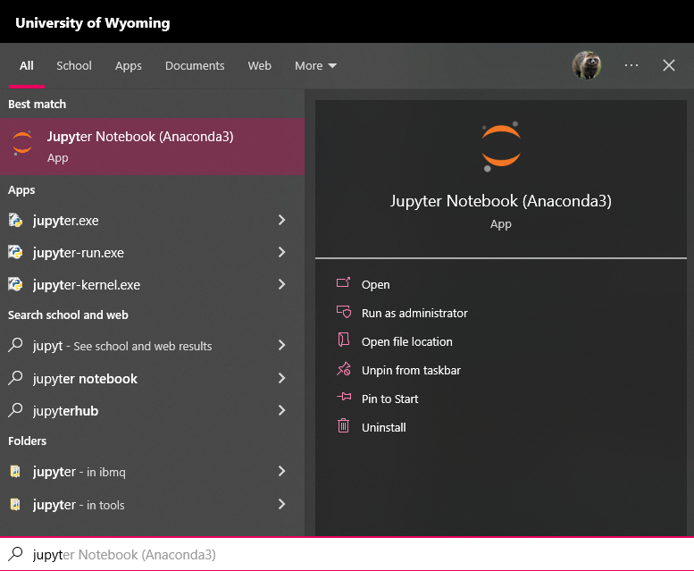
Code
The code can be run in Jupyter Notebook
To launch Jupyter Notebook, click on the Windows search bar and type “Jupyter Notebook”, then click open or press enter

Slide 5
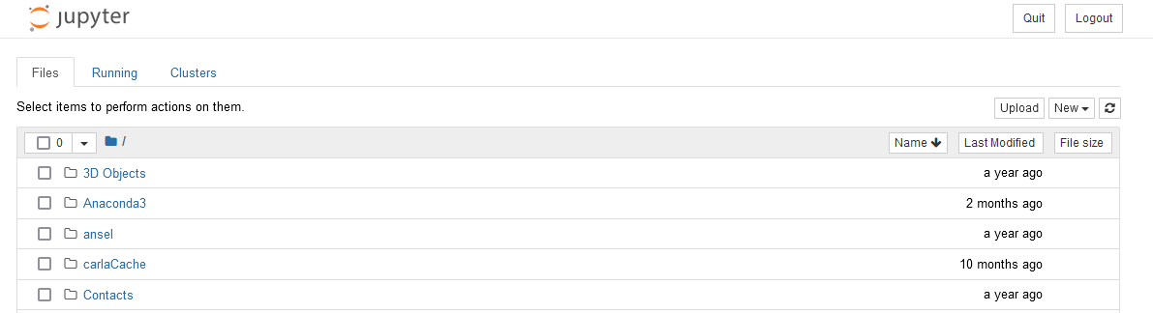
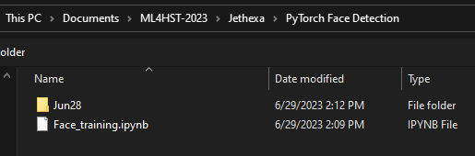
Code
In Jupyter Notebook, click “Upload” in the top right corner
Then navigate to the “Jethexa” folder in the workshop materials, and upload the “Face_training.ipynb”

Slide 6
Code
Navigate to the notebook you uploaded, and click to open it

Slide 7
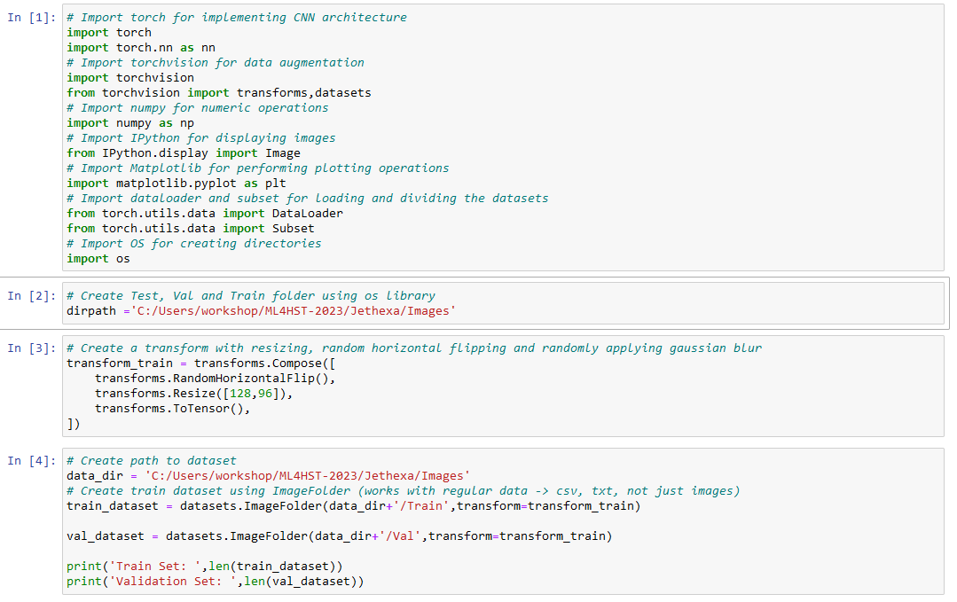
Code
The image directory path should already be correct, but make sure it is pointing to the correct place (refer to red arrows)

Slide 8
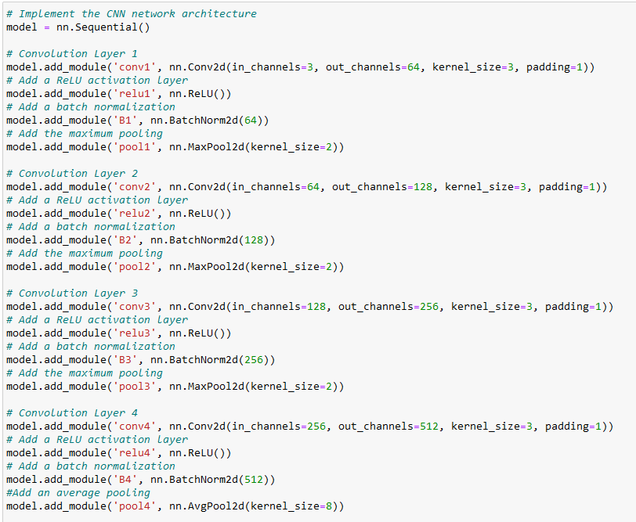
Code
The module on the left is where to model architecture is defined
We are building a Convolutional Neural Network with 4 Convolutional Layers

Slide 9
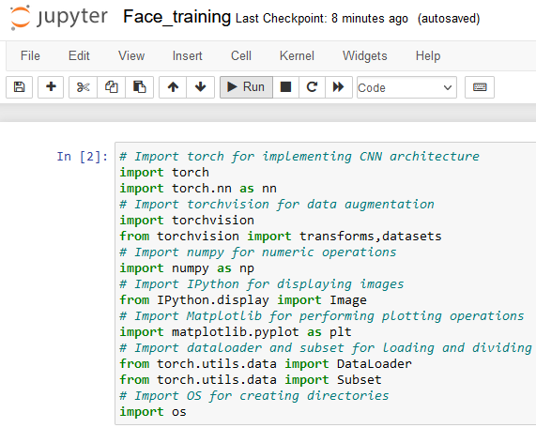
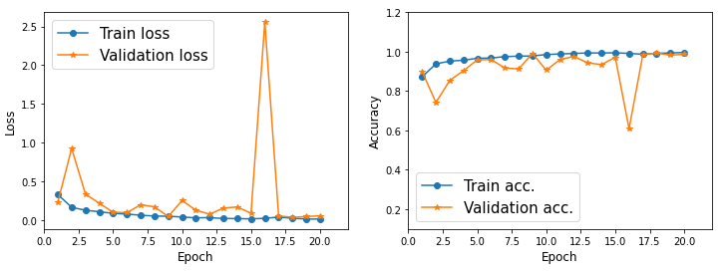
Executing the Code
Click on each cell in order and click “Run” on the top of the screen (red arrow)
After training, you should see similar graphs to what can be seen below

Slide 10
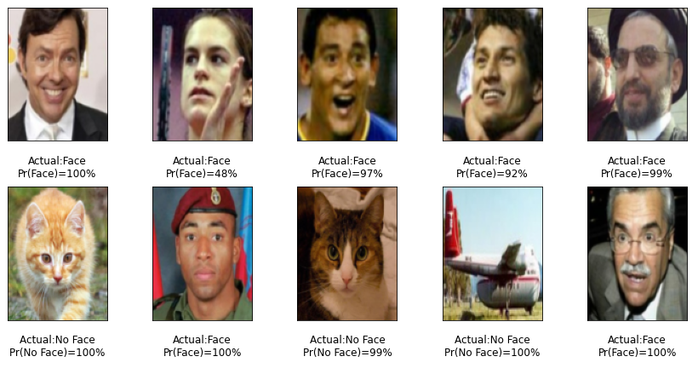
Testing the Model
In the last cell of the code, the model is loaded and run on some test data
You should see a probability and the actual classification of what each image is

Slide 11
Analysis
From this demonstration, it should be seen how you could train a similar model to the MediaPipe Face Detection model used in the last JetHexa demonstration
This model could then be exported and used on the JetHexa in the same MediaPipe code, if time was available

